Slide 1



CHAT APPLICATION
Based on Server-Client using Socket Programming

Slide 2
FUNNEL
INTRODUCTION
Socket Progrmming
OBJECTIVES
Process
DEFINITION
Project Definition
CONCEPTS
About Server & Client
OVERVIEW
Project Code and Output Screen
CONCLUSION
What we understand about a project

Slide 3
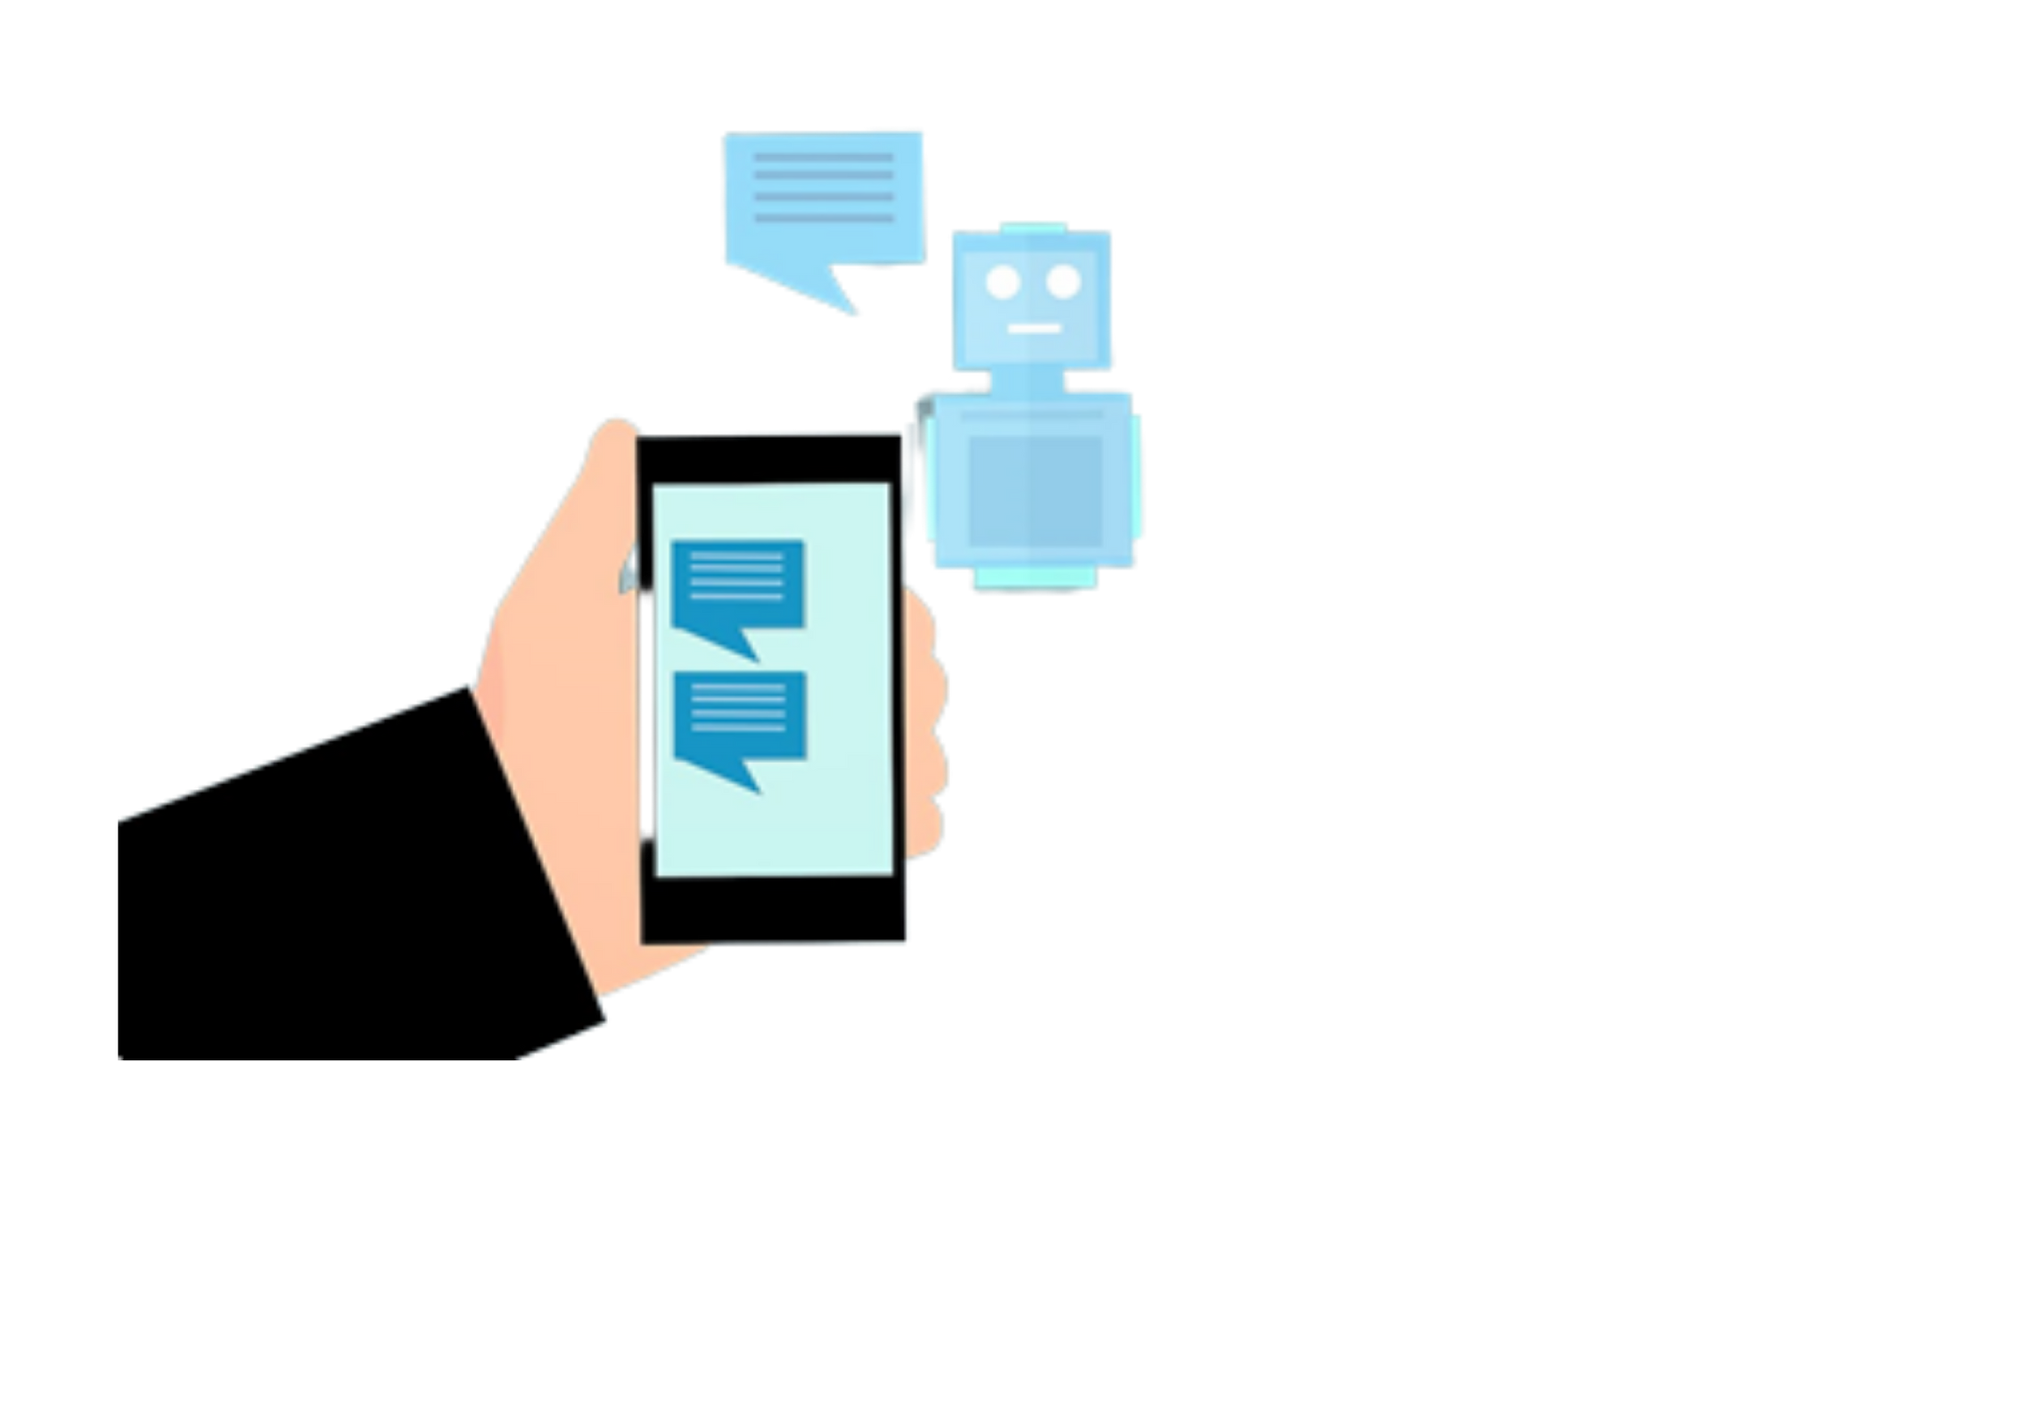
INTRODUCTION
Chatting Application is a desktop based application.
A socket is one endpoint of a two-way communication link between two programs running on the network. A socket is bound to a port number so that the TCP layer can identify the application that data is defined to be sent to.
This client server chat application is based on java socket programming.

Slide 4
OBJECTIVE
The aim of this project is to express how we can implement a simple chat application between a server and a client?
The application is a desktop based application The project is developed in Java SE language executed on a single stand-alone java across a network using loop back address concept.
Application consists of two programs: Client & Server
Transmission Control Protocol is a standard that defines how to establish and maintain a network conversation via which application programs can exchange data. TCP works with the Internet Protocol (IP), which defines how computers send packets of data to each other.

Slide 5
SERVER - CLIENT
Server: Chat-Application provide the process of talking to other people who are using the Internet at the same time you are. The server module of the application waits for the client to connect to it. Then if connection is granted a client interacts communicates and connects to the server, it can mutually communicate with the server. The duty of the server is to let clients exchange the messages.
Client: A Client is a computer that request services from a server computer. A Server is computer that provides services to clients and controls access to hardware software and other resources. The client module is the one that utilizer sends requests to the server. Utilizer utilizes the client as the means to connect to the server. Once he establishes the connection, he can communicate to the connected server.

Slide 6
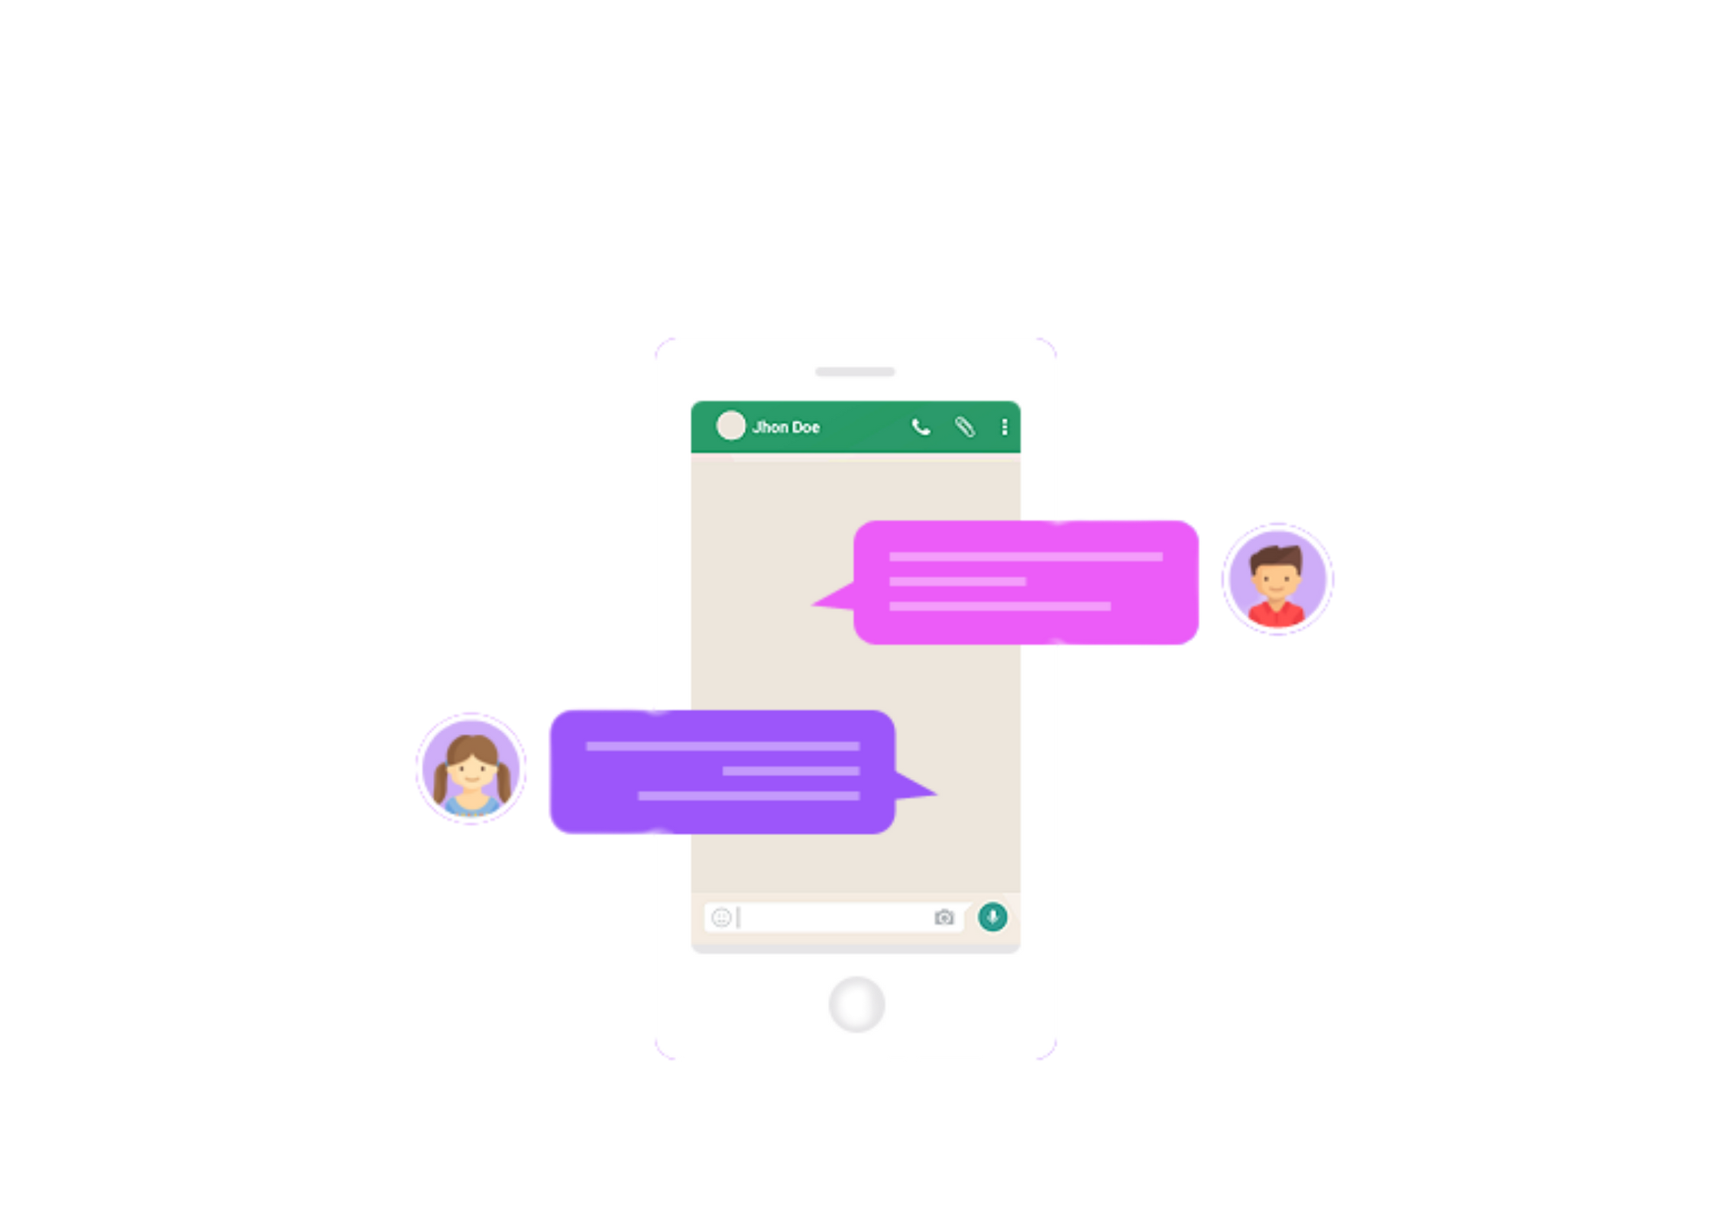
OPERATIONAL CONCEPTS AND SCENARIOS
Operation of the application based on the inputs given by the user:
When the run button is clicked then the chat form is initialized with a connection between the host and the client machine.
Contains a rich textbox which send messages from one user to another
Contains a textbox for messages to be written that is sent across the network.
When the Enter clicked, in the background, the text in the textbox is encoded and sent as a packet over the network to the client machine. Here this message is decoded and is shown in the rich textbox.

Slide 7
PROJECT SCOPE
This project can be mainly divided into two modules:
1. Server
2. Client
This project is mainly depended on client/server model. The client requests the server and server responses by granting the clients request. The proposed system should provide both of the above features along with the followed ones:
The Server Screen
The Client Screen
The Server-Client Screen

Slide 8
SERVER SIDE CODE
import java.io.BufferedReader;
import java.io.IOException;
import java.io.InputStreamReader;
import java.io.PrintWriter;
import java.net.InetAddress;
import java.net.ServerSocket;
import java.net.Socket;
import java.util.ArrayList;
public class SocketServer {
ServerSocket server;
Socket sk;
InetAddress addr;
ArrayList<ServerThread> list = new ArrayList<ServerThread>();
public SocketServer() {
try {
addr = InetAddress.getByName("127.0.0.1");
server = new ServerSocket(1234, 50, addr);
System.out.println("\nWaiting for Client connection");
SocketClient.main(null);
while (true) {
sk = server.accept();
System.out.println(sk.getInetAddress() + " connect");
// Thread connected clients to ArrayList
ServerThread st = new ServerThread(this);
addThread(st);
st.start();
}
} catch (IOException e) {
System.out.println(e + "-> ServerSocket failed");
}
}

Slide 9
SERVER SIDE CODE
public void addThread(ServerThread st) {
list.add(st);
}
public void removeThread(ServerThread st) {
list.remove(st); // remove
}
public void broadCast(String message) {
for (ServerThread st : list) {
st.pw.println(message);
}
}
public static void main(String[] args) {
new SocketServer();
}
}

Slide 10
SERVER SIDE CODE
class ServerThread extends Thread {
SocketServer server;
PrintWriter pw;
String name;
public ServerThread(SocketServer server) {
this.server = server;
}
@Override
public void run() {
try {
// read
BufferedReader br = new BufferedReader(new InputStreamReader(server.sk.getInputStream()));
// writing
pw = new PrintWriter(server.sk.getOutputStream(), true);
name = br.readLine();
server.broadCast("[" + name + "] joined");
String data;
while ((data = br.readLine()) != null) {
if (data == "/list") {
pw.println("a");
}
server.broadCast("[" + name + "] " + data);
}
} catch (Exception e) {
// Remove the current thread from the ArrayList.
server.removeThread(this);
server.broadCast("[" + name + "] Left");
System.out.println(server.sk.getInetAddress() + " - [" + name + "] Exit");
System.out.println(e + "---->");
}
}
}

Slide 11
CLIENT SIDE CODE
import javax.swing.*;
import java.awt.*;
import java.awt.event.ActionEvent;
import java.awt.event.ActionListener;
import java.io.BufferedReader;
import java.io.InputStreamReader;
import java.io.PrintWriter;
import java.net.Socket;
@SuppressWarnings("serial")
public class SocketClient extends JFrame implements ActionListener, Runnable {
JTextArea textArea = new JTextArea();
JScrollPane jp = new JScrollPane(textArea);
JTextField input_Text = new JTextField();
JMenuBar menuBar = new JMenuBar();
Socket sk;
BufferedReader br;
PrintWriter pw;

Slide 12
CLIENT SIDE CODE
public SocketClient() {
super("Chat Application");
setFont(new Font("Arial Black", Font.PLAIN, 12));
setForeground(new Color(0, 0, 51));
setBackground(new Color(51, 0, 0));
textArea.setToolTipText("Chat History");
textArea.setForeground(new Color(50, 205, 50));
textArea.setEditable(false);
textArea.setFont(new Font("Monospaced", Font.BOLD, 13));
textArea.setBackground(new Color(0, 0, 0));
getContentPane().add(jp, "Center");
input_Text.setText("Enter your Message:");
input_Text.setToolTipText("Enter your Message");
input_Text.setForeground(new Color(0, 0, 0));
input_Text.setFont(new Font("Tahoma", Font.BOLD, 11));
input_Text.setBackground(new Color(230, 230, 250));
getContentPane().add(input_Text, "South");
setSize(325, 411);
setVisible(true);
input_Text.requestFocus(); // Place cursor at run time, work after screen is shown
setDefaultCloseOperation(JFrame.EXIT_ON_CLOSE);
input_Text.addActionListener(this); // Event registration
}

Slide 13
CLIENT SIDE CODE
public void serverConnection() {
try {
String IP = JOptionPane.showInputDialog(this, "Please Enter a Server IP Address",
JOptionPane.INFORMATION_MESSAGE);
sk = new Socket(IP, 1234);
String name = JOptionPane.showInputDialog(this, "Please Enter Your Name", JOptionPane.INFORMATION_MESSAGE);
/*
* while (name.length() > 7) { name = JOptionPane.showInputDialog(this,
* "Please enter a nickname.(7 characters or less)",
* JOptionPane.INFORMATION_MESSAGE); }
*/
// read
br = new BufferedReader(new InputStreamReader(sk.getInputStream()));
// writing
pw = new PrintWriter(sk.getOutputStream(), true);
pw.println(name); // Send to server side
new Thread(this).start();
} catch (Exception e) {
System.out.println(e + " Socket Connection error");
}
}

Slide 14
CLIENT SIDE CODE
public static void main(String[] args) {
new SocketClient().serverConnection(); // Method call at the same time object creation
}
@Override
public void run() {
String data = null;
try {
while ((data = br.readLine()) != null) {
textArea.append(data + "\n"); // textArea Decrease the position of the box's scroll bar by the length of
// the text entered
textArea.setCaretPosition(textArea.getText().length());
}
} catch (Exception e) {
System.out.println(e + "--> Client run fail");
}
}
@Override
public void actionPerformed(ActionEvent e) {
String data = input_Text.getText();
pw.println(data); // Send to server side
input_Text.setText("");
}
}

Slide 15
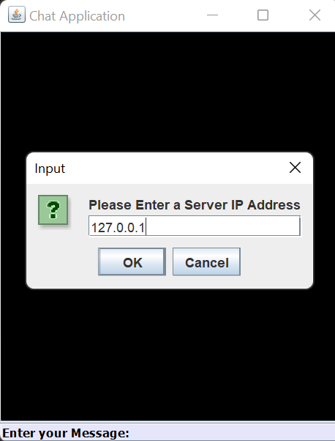
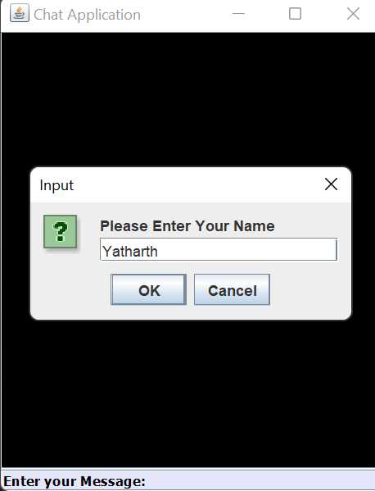
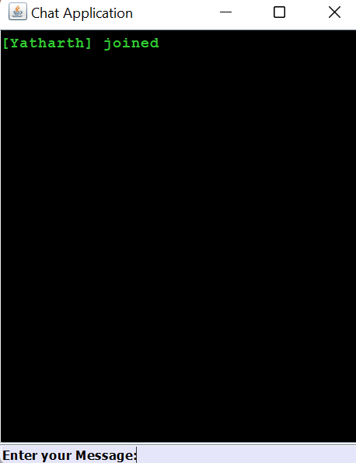
SERVER SCREEN

Slide 16
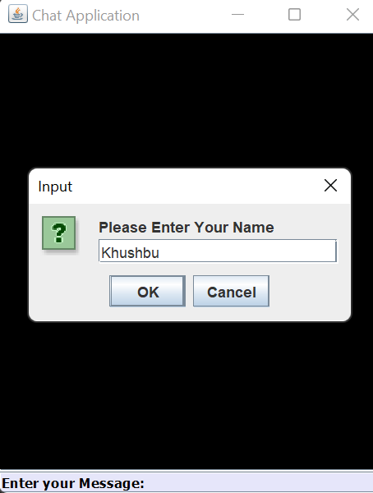
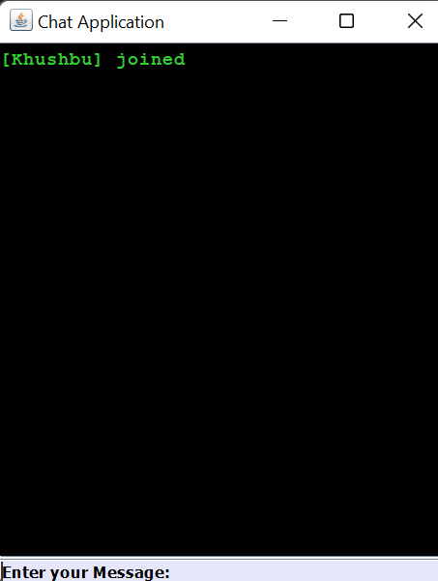
CLIENT SCREEN

Slide 17
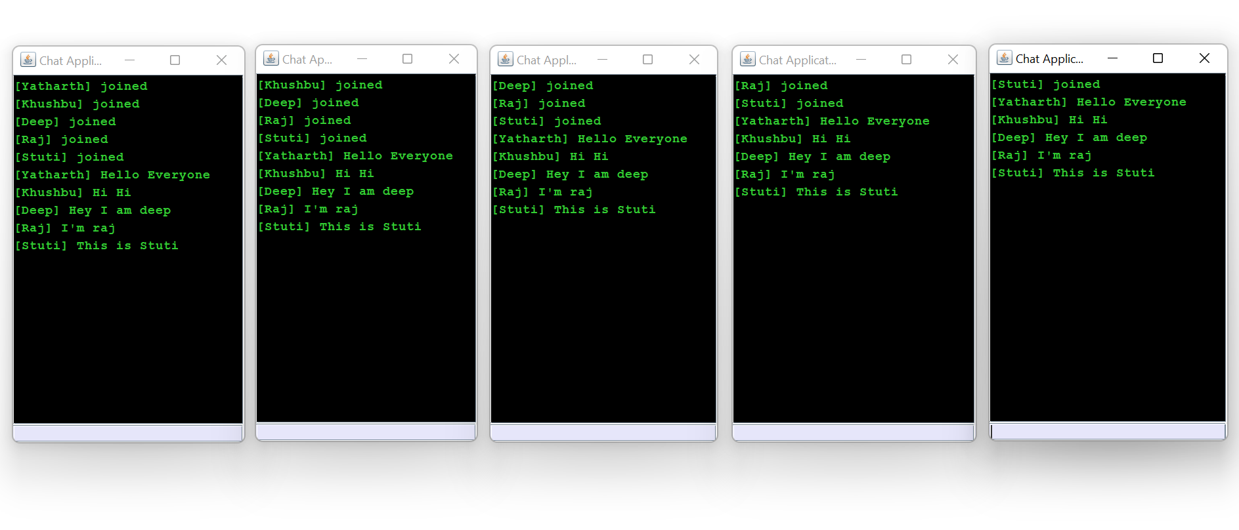
SERVER-CLIENT SCREEN

Slide 18
ADVANTAGES & DISADVANTAGES
ADVANTAGES
Provides flexible access to files and data over a network.
Cause low network traffic if efficiently used.
Only updated information can be sent.
DISADVANTAGES
The Java applets can establish communication only with the machine requested and not with any other machine on the network.
Sockets allow only raw data to be sent. This means that both client and server need to have mechanisms to interpret the data.
Can’t handle program crush.
If server fails, Whole system will fail.

Slide 19
CONCLUSION
We developed network applications in Java by using sockets, threads, and Web services .These software is portable, efficient, and easily maintainable for large number of clients.
Our developed web-based chatting software is unique in its features and more importantly easily customizable.
Typically, programs running on client machines make requests to programs on a server Machine. These involve networking services provided by the transport layer. TCP is a connection-oriented protocol providing a reliable flow of data between two computers.

Slide 20
THANKS!
Prepared By:
20DCE012 – Stuti Bhatt
20DCE016 – Khushbu Chauhan
20DCE017 – Raj Chauhan
20DCE019 – Yatharth Chauhan
20DCE024 – Deep Dhaduk

